Slide 1
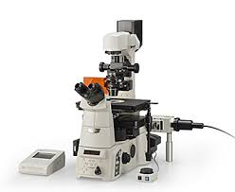
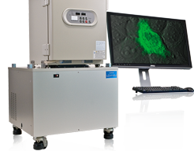
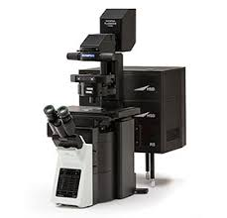
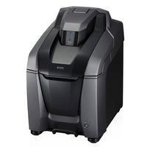
Stem Cell Research Center Imaging Core Instruments
Start
Does your specimen have a heartbeat?
Will you image or perform microdissections?
Will you do it manually or require more precision with a laser?
Zeiss PALM MicroBeam
Inverted Widefield
Room 2406
Recharge Rate: $24/hr
Laser Micro-dissection Pressure Catapulting (LMPC)
5x, 10x, 20x, & 40x
DAPI, GFP, Rhod, & Cy5 filter cubes
No
Dissect
Laser!
Yes
Image
Manually
Caliper Lumina I IVIS
Vivarium B640
Recharge Rate: $40/hr
Live animal imaging
Fluorescence & Luminescence
Isofluorane for three animals at a time
Is your sample alive in a dish or dead and fixed to a slide?
Nikon SMZ1500
Dissection
Room 1402
Fluorescent dissection imaging
0.75x to 11.25x
GFP & RFP filter cubes
Fiber optic light source
Color camera
Scopes without Incubation
Scopes with Incubation
System | Features | Benefits |  | Applications
Nikon Ti-E Inverted Widefield Room 1402 | Basic research microscope 4x, 10x, 20x, 40x, 60x (oil), & 100x (oil) DAPI, FITC, TRITC, TxRed, & Cy5 filter cubes Equipped with Perfect Focus System | Many vessel holders Control focus drift Reduces background |  | Fluorescence Brightfield Phase
 |  |  |  | Fluorescence Brightfield Phase
Nikon Ti-E Inverted Widefield Room 3402 | Basic research microscope 4x, 10x, 20x, 20LWDx, 40x, & 60x (oil) DAPI, FITC, TxRed, & Cy5 filter cubes Equipped with Perfect Focus System | Many vessel holders Control focus drift Reduces background
Olympus FSX100 Inverted Widefield Room 3401 | Compact benchtop system (scope-in-a-box) 10x & 40x DAPI, FITC, & TRITC Long-Pass filter cubes | Self-contained unit Controls room light |  | Fluorescence Brightfield Phase
Keyence BZX-810 Inverted Widefield Room 2301 Olympus FV3000 Laser Scanning Inverted Confocal Room 1402 Recharge Rate: $25/hr | Compact benchtop system (scope-in-a-box) 4x, 10x, 20x, 20x LWD, 40x, & 63x (oil) DAPI, GFP, TRITC, TxRed, & Cy5 filter cubes Equipped with Auto Focus Optical sectioning module High-powered fluorescent live cell imaging 2x ma-PMTs & 2x GaAsP-PMTs 1.25x, 10x, 20x, & 40x (oil) 405nm, 488nm, 561nm, & 640nm laser lines FUW, FBN, & FGW (RBG) filter cubes Tokai-HIT stage top incubator Olympus TruSpectral detection | Self-contained unit Controls room light Large area scanning Corrects focus drift Galvo/resonant hybrid scanner Fast acquisition speeds Large area scanning Corrects focus drift Zoom feature Deconvolution image processing |  | Fluorescence Brightfield Phase Fluorescence DIC
System | Features | Benefits |  | Applications
Olympus FV10i-LIV Inverted Confocal Room 2406 | Compact benchtop system (scope-in-a-box) Laser Scanning 10x & 60x (water) 405nm, 473nm, 559nm, & 635nm lasers | Self-contained unit Controls room light Confocal imaging of live cells |  | Fluorescence Phase
Olympus VivaView Inverted Widefield Room 2406 | Stable live cell imaging 10x, 20x, & 40x DAPI, GFP, mOrange, TxRed, HcRed, & Cy5 filter cubes | Stable incubation settings |  | Fluorescence Brightfield DIC
Olympus FV3000 Laser Scanning Inverted Confocal Room 1402 Recharge Rate: $25/hr | High-powered fluorescent live cell imaging 2x ma-PMTs & 2x GaAsP-PMTs 1.25x, 10x, 20x, & 40x (oil) 405nm, 488nm, 561nm, & 640nm laser lines FUW, FBN, & FGW (RBG) filter cubes Tokai-HIT stage top incubator Olympus TruSpectral detection | Galvo/resonant hybrid scanner Fast acquisition speeds Large area scanning Corrects focus drift Zoom feature Deconvolution image processing |  | Fluorescence DIC
Contact Information _____
Allia Fawaz, M.S. FawazA@uci.edu (949) 824-0430
SCRC Core Microscope Imaging Manager
Gross Hall Building Manager

Slide 2
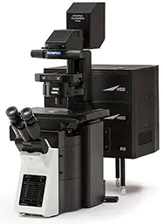
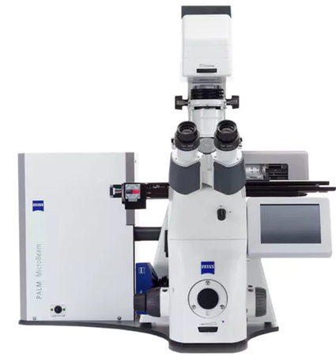
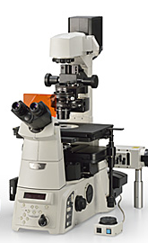
Stem Cell Research Center Imaging Core Instruments
Microscope Imaging Systems | Features | Benefits | System | Applications
Olympus FV3000 Laser Scanning Inverted Confocal Room 1402 Recharge Rate: $25/hr | High-powered fluorescent live cell imaging 2x ma-PMTs & 2x GaAsP-PMTs 1.25x, 10x, 20x, & 40x (oil) 405nm, 488nm, 561nm, & 640nm laser lines FUW, FBN, & FGW (RBG) filter cubes Tokai-HIT stage top incubator Olympus TruSpectral detection | Galvo/resonant hybrid scanner Fast acquisition speeds Large area scanning Corrects focus drift Zoom feature Deconvolution image processing |  | Fluorescence DIC
Keyence BZX-810 Inverted Widefield Room 2301 | Compact benchtop system (scope-in-a-box) 4x, 10x, 20x, 20x LWD, 40x, & 63x (oil) DAPI, GFP, TRITC, TxRed, & Cy5 filter cubes Equipped with Auto Focus Optical sectioning module | Self-contained unit Controls room light Large area scanning Corrects focus drift |  | Fluorescence Brightfield Phase
Olympus FV10i-LIV Inverted Confocal Room 2406 | Compact benchtop system (scope-in-a-box) Laser Scanning 10x & 60x (water) 405nm, 473nm, 559nm, & 635nm lasers | Self-contained unit Controls room light Confocal imaging of live cells |  | Fluorescence Phase
Olympus VivaView Inverted Widefield Room 2406 | Stable live cell imaging 10x, 20x, & 40x DAPI, GFP, mOrange, TxRed, HcRed, & Cy5 filter cubes | Stable incubation settings |  | Fluorescence Brightfield DIC
Olympus FSX100 Inverted Widefield Room 3401 | Compact benchtop system (scope-in-a-box) 10x & 40x DAPI, FITC, & TRITC Long-Pass filter cubes | Self-contained unit Controls room light |  | Fluorescence Brightfield Phase
Nikon Ti-E Inverted Widefield Room 1402*, 3402** | Basic research microscope 4x, 10x, 20x, 20xLWD**, 40x, 60x (oil), & 100x (oil)* DAPI, FITC, TRITC, TxRed, & Cy5 filter cubes Equipped with Perfect Focus | Many vessel holders Reduces background Control focus drift |  | Fluorescence Brightfield Phase
Other Imaging Systems | Features & Benefits
Caliper Lumina I IVIS Room: Vivarium B640 Recharge Rate: $40/hr | Live animal imaging Fluorescence & Luminescence Isofluorane for three animals at a time
Zeiss PALM MicroBeam Inverted Widefield Room 2406 Recharge Rate: $24/hr | Laser Micro-dissection Pressure Catapulting (LMPC) 5x, 10x, 20x, & 40x DAPI, GFP, Rhod, & Cy5 filter cubes
Nikon SMZ1500 Dissection Room 1402 | Fluorescent dissection imaging 0.75x to 11.25x GFP & RFP filter cubes Fiber optic light source Color camera
Contact Information _____
Allia Fawaz, M.S. FawazA@uci.edu (949) 824-0430
SCRC Core Microscope Imaging Manager
Gross Hall Building Manager

